Slide 1
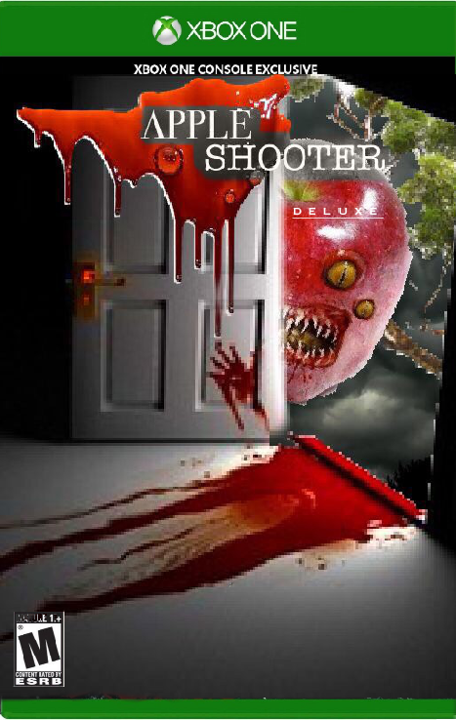
Apple Shooter
Developed by Greg Rapp

Slide 2
Apple Shooter Goals
Develop a shooter game that runs smoothly and intuitively
Incorporate Fractal design into the game
Utilize different functions of the graphical user interface
Utilize different attributes of plotted objects

Slide 3
Features Completed
Creating a GUI axis that plots a fractal tree
Tracking the position of the mouse
Mouse down and up functions
Projectile shooting
Collision detection
Updating various attributes of plotted objects
Radio buttons
Score based on timer

Slide 4
Demonstration
Apple Shooter
https://drive.google.com/drive/folders/1PltJMgmbchqGZnWueP8iz0vKl5rtCD52?usp=sharing

Slide 5
References
https://www.mathworks.com/matlabcentral/fileexchange/29536-generation-of-2d-fractal-trees
https://www.mathworks.com/matlabcentral/fileexchange/31330-dave-s-matlab-shooter

